Slide 1
MINI PROJECT 2021 Record Manager
Presented By:
Chanchal(191500224)
Aparna singh(191500144)

Slide 2
OUTLINE
About the Project
Objective
Requirements
Snapshots from the website

Slide 3
ABOUT THE PROJECT
Over the years the manual teacher's record management has been carried across most educational institutions all over India. To overcome the problems of manual record management, We have developed a “web-based RECORD MANAGER”. which is based on a web server, which can be implemented on any computer. This project is aimed at developing a “Record Manager” that is of importance to either an educational institution or a college. As it will provide ideal support for all the actor’s i.e. Teachers, Admin, departments for better management when providing the facility to submit records of teacher's documents. In this application, firebase used as back-end design, and HTML, CSS, and JavaScript are used as front-end tools.

Slide 4
OBJECTIVE
The purpose of this document includes an overview of the “RECORD MANAGER” web application, detailed information about the requirements including functional requirements, interface requirements, non-functional requirements, and additional constraints of the system. This Software Requirement Specification will provide a complete description of all the functions and specifications. This document will let know the reader about every detail of our product like its functionality, uses, problems, etc

Slide 5
REQUIREMENTS
Software Specification Used:-
Browser : Internet Explorer 7+ onwards, Mozilla Firefox 46+, Google Chrome version 49+ onwards Operating System :Any Operating System
RAM : 8 GB (or higher)
Hard disk : 256GB

Slide 6
Hardware Used:
Processor Used: Intel i5
Operating System: Windows 10
RAM: 4 +GB (minimum)
Hardware Devices: Computer System
Hard Disk: 256 GB

Slide 7
THIS IS HOW OUR PROJECT LOOKS
Hope you will like it :)

Slide 8
1 .HOME PAGE

Slide 9
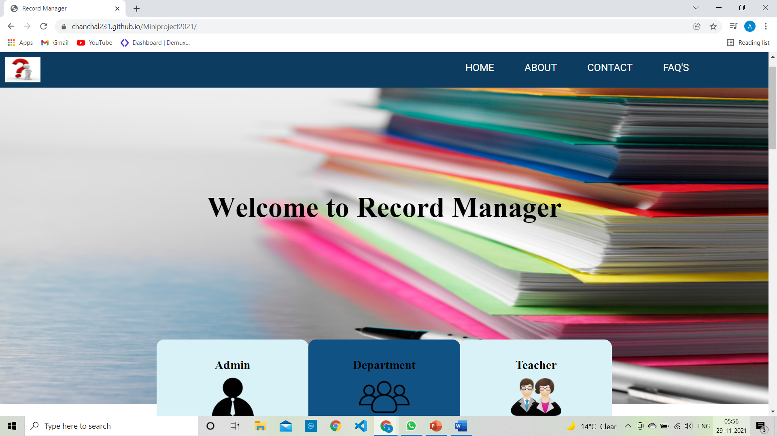

Slide 10
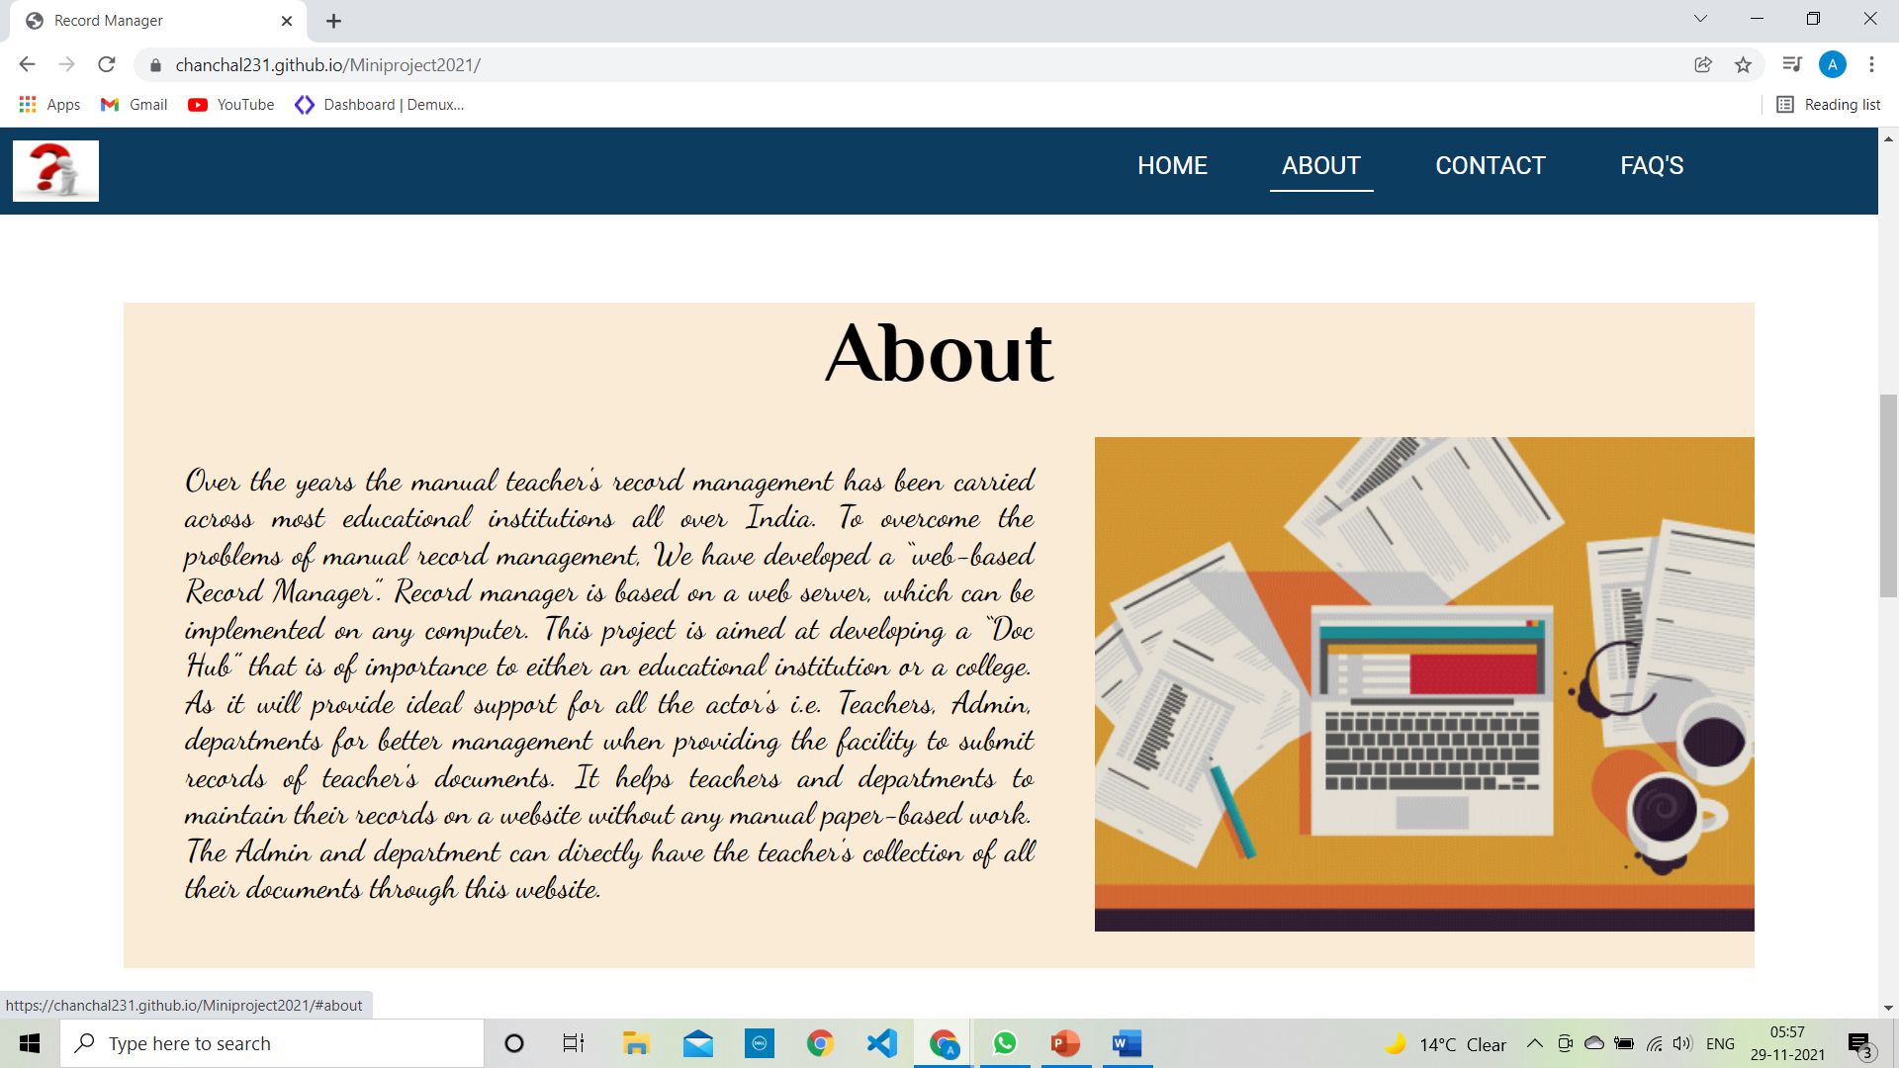

Slide 11
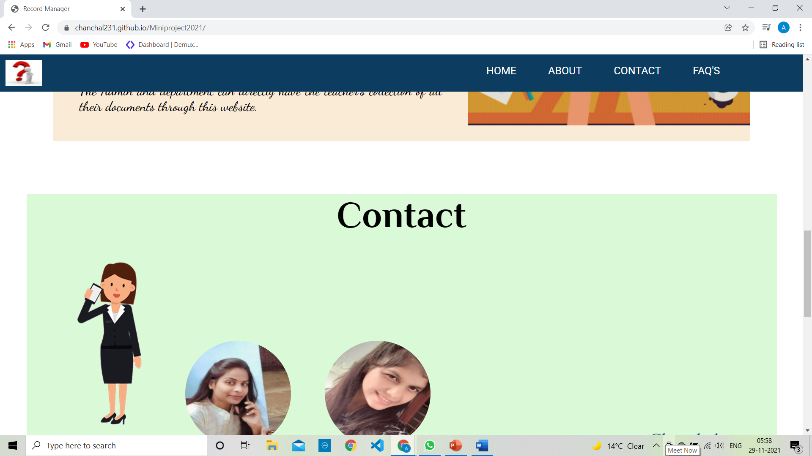

Slide 12
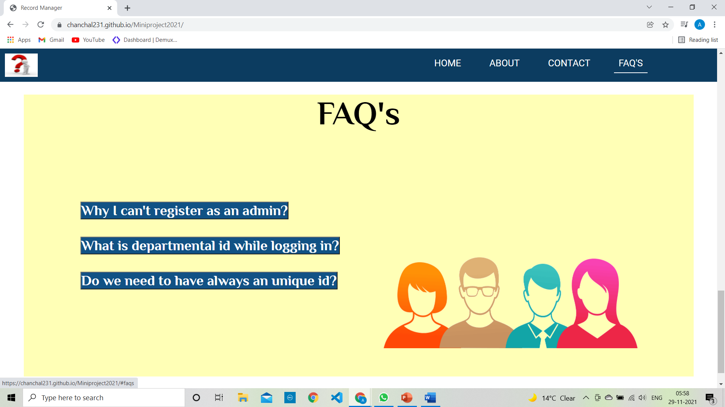

Slide 13
MODULES:-

Slide 14
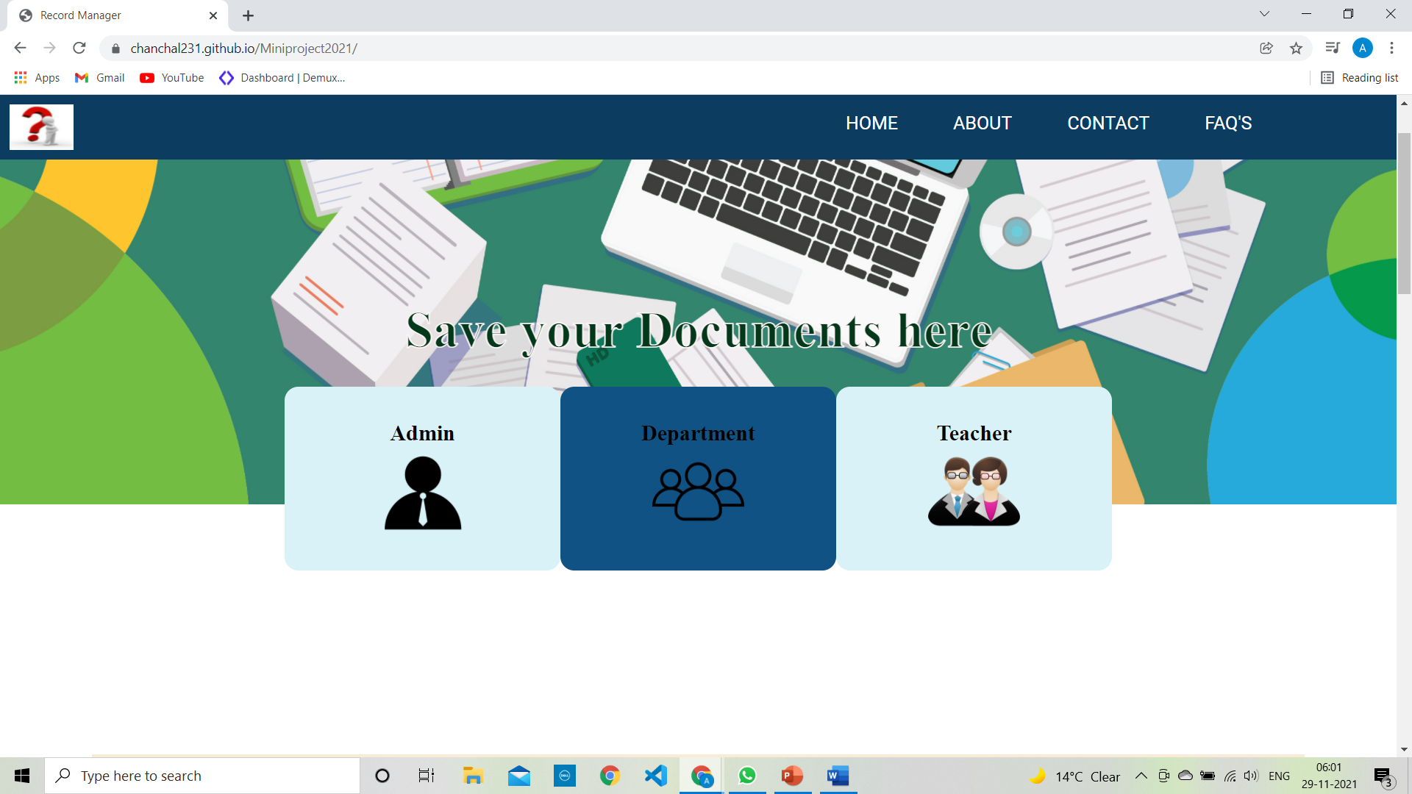

Slide 15
ADMIN Login Submodules:- 1. Add department 2. Remove Department 3.Department List 4.View Teacher Record 5. Search Record 6.Generate Record

Slide 16
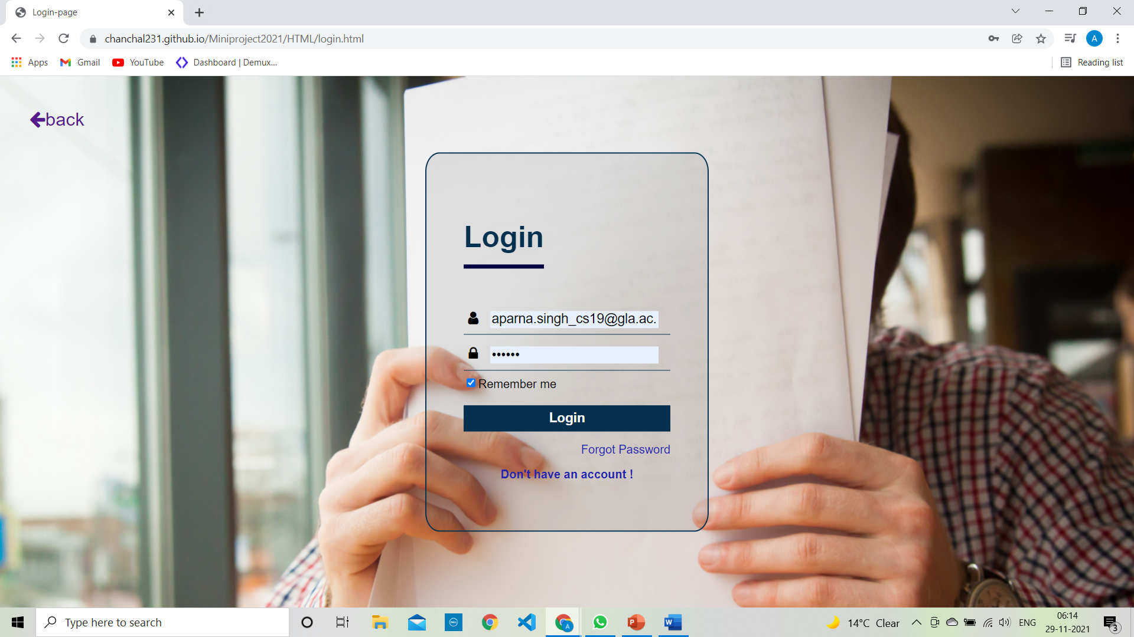

Slide 17
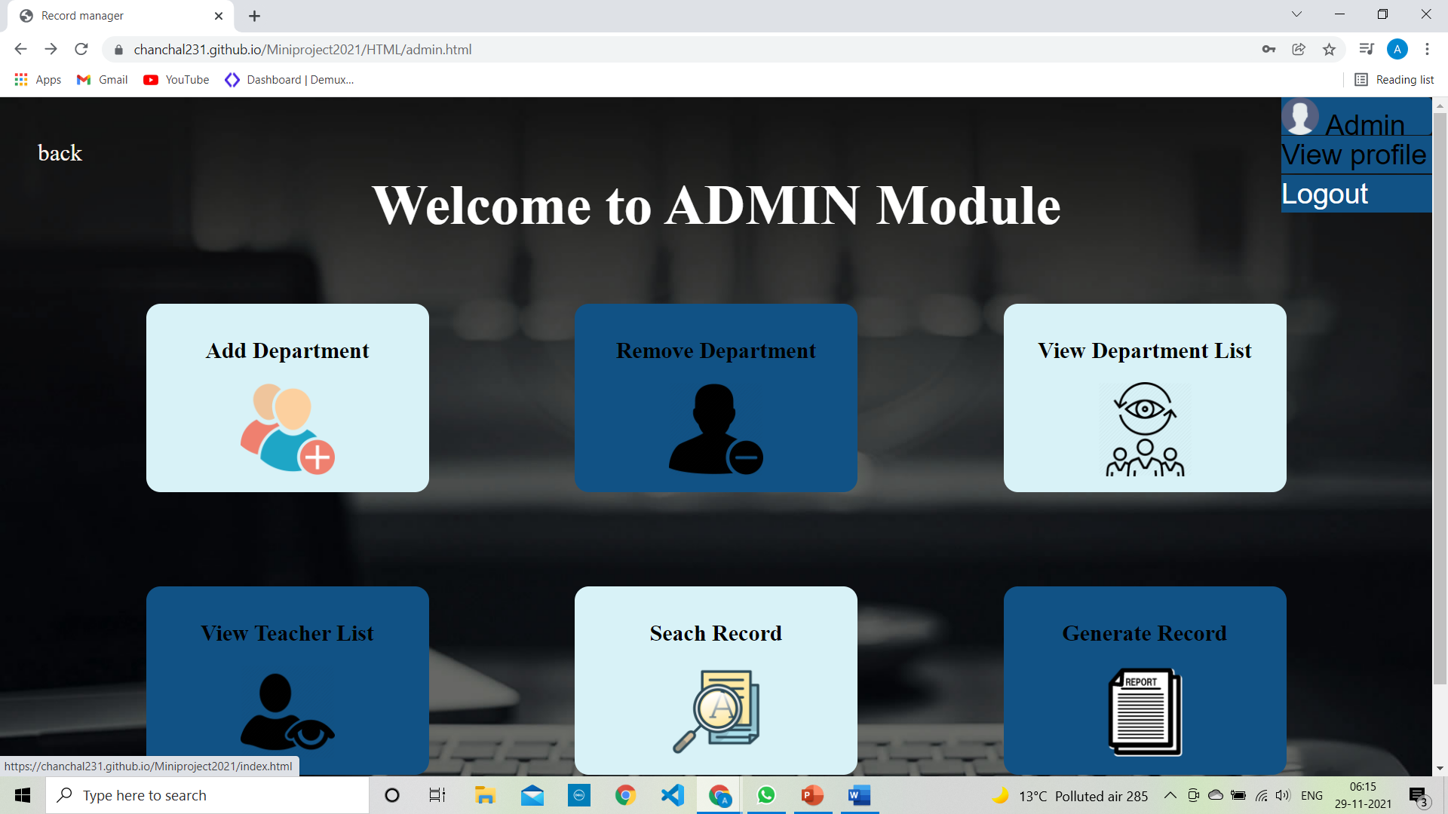

Slide 18
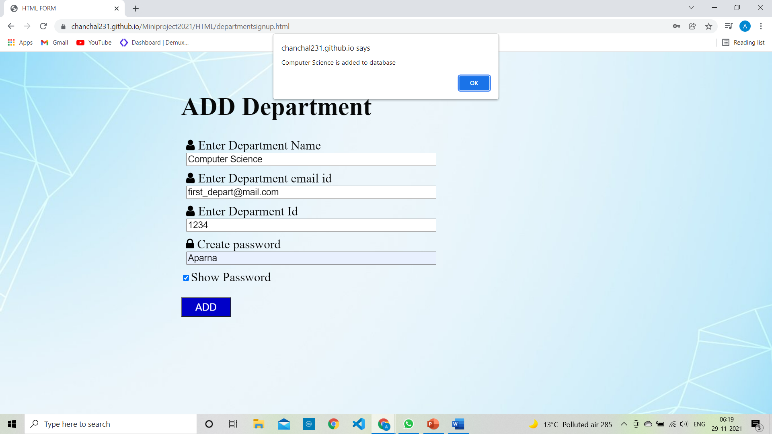

Slide 19
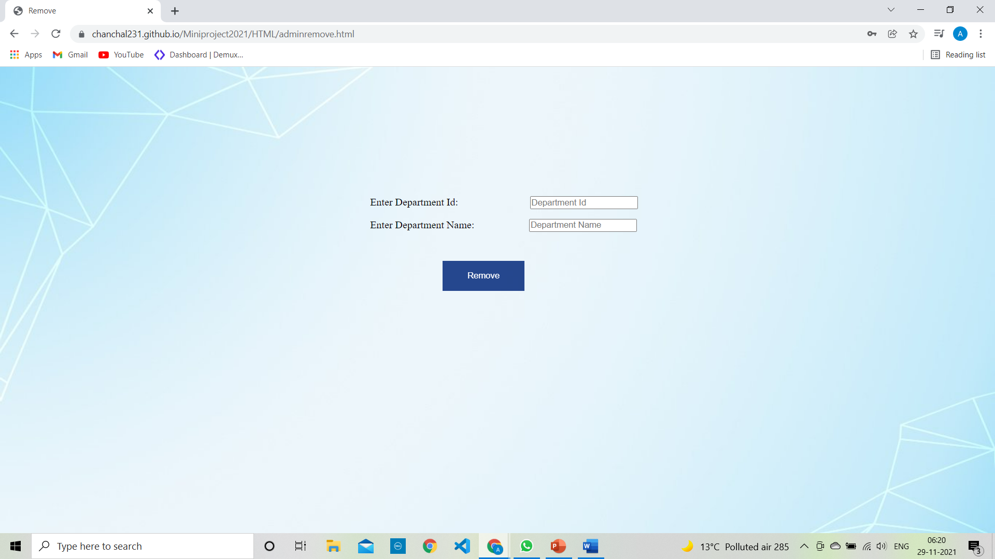

Slide 20
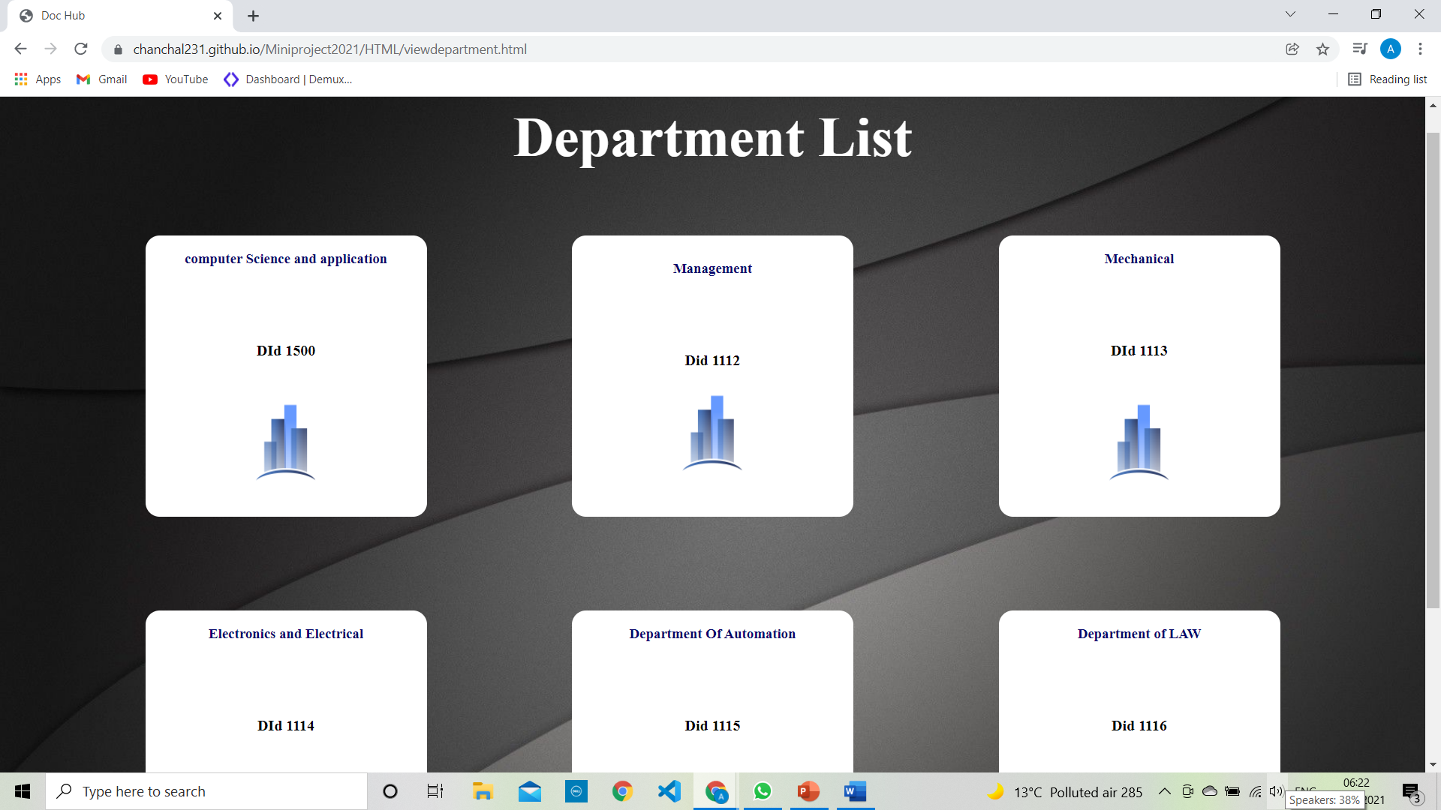

Slide 21
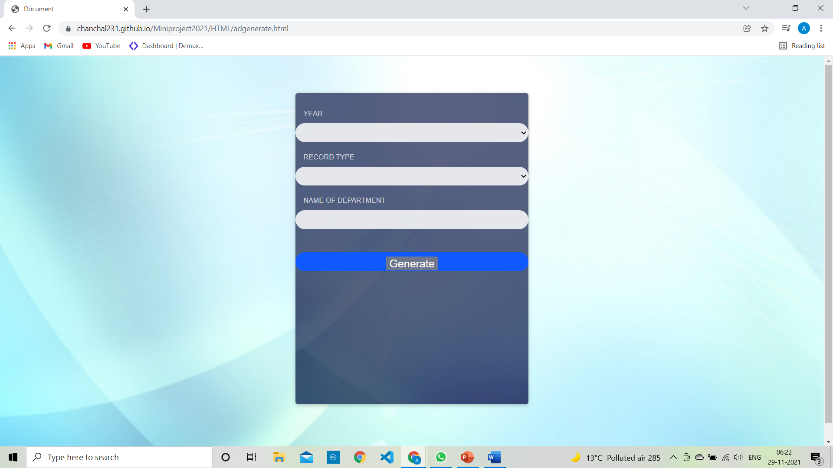

Slide 22
Department Module Login 1. Add Teacher 2.Remove Teacher 3.Generate Record

Slide 23
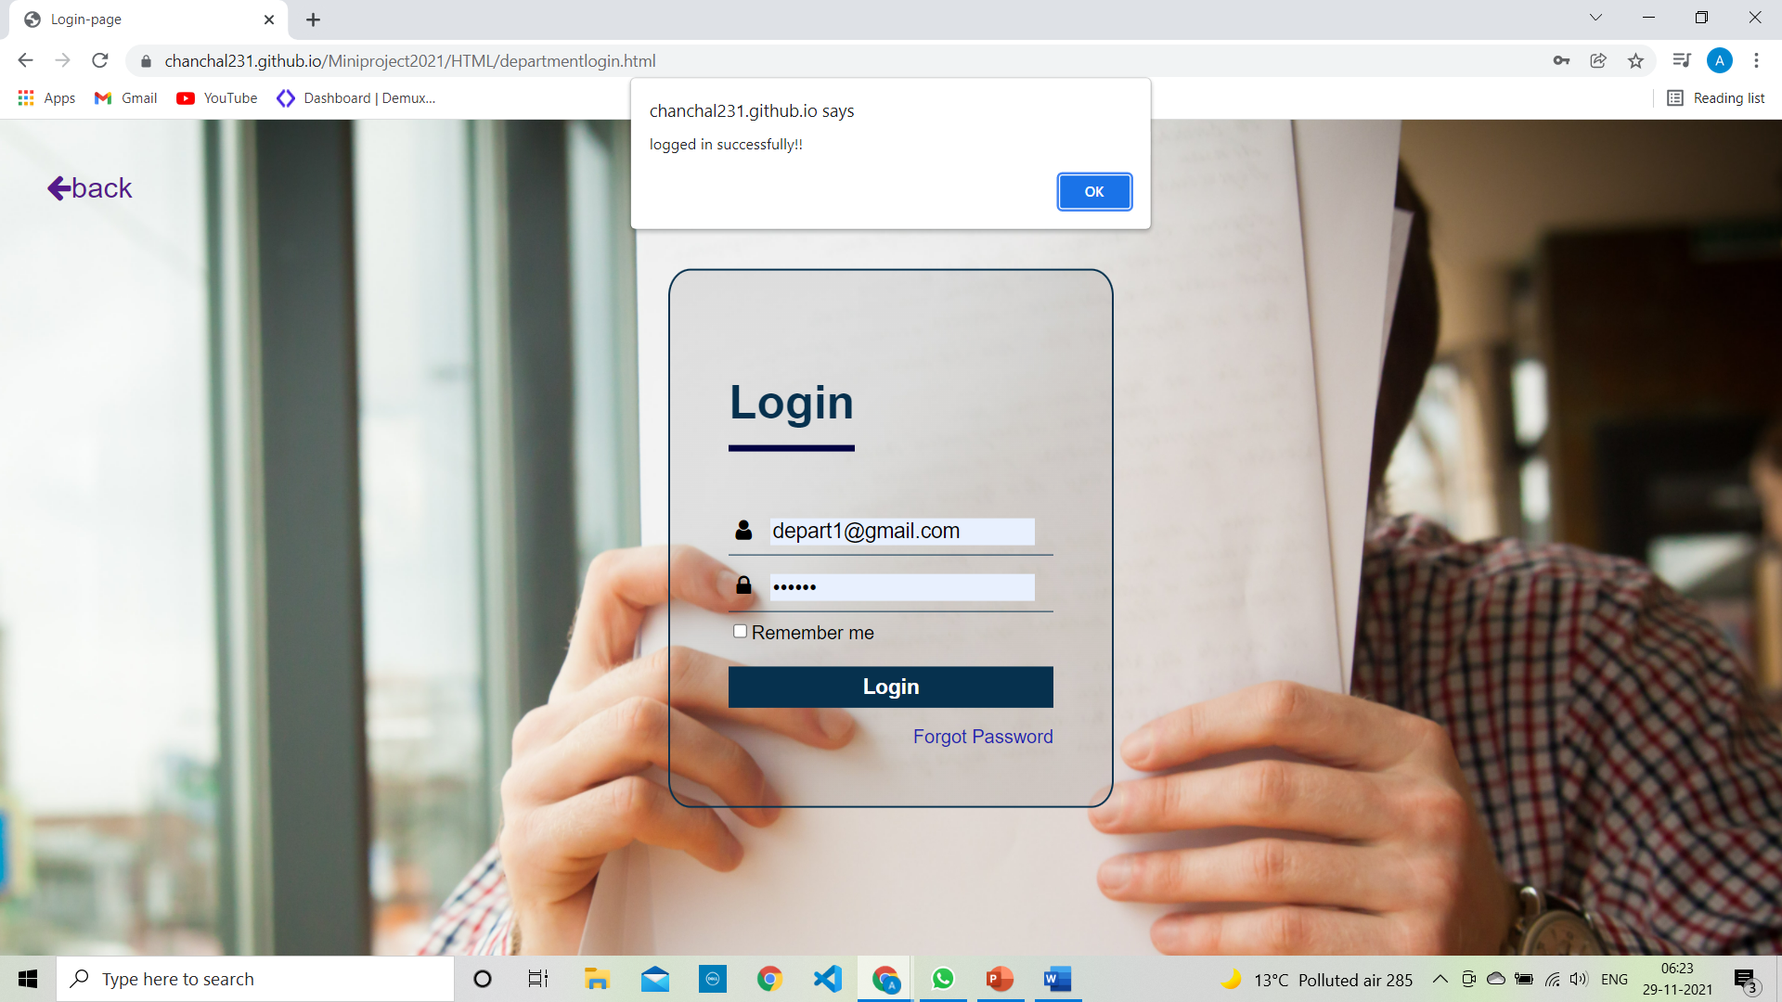

Slide 24
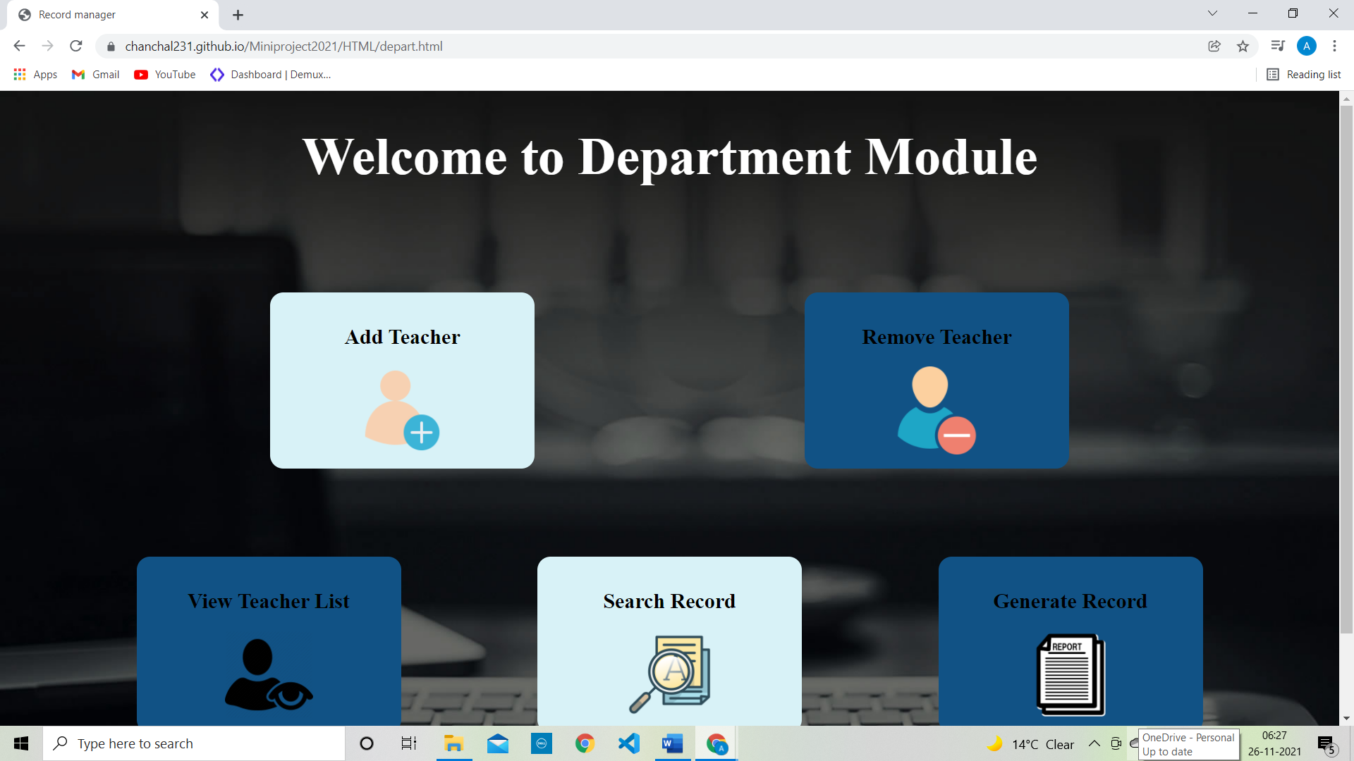

Slide 25
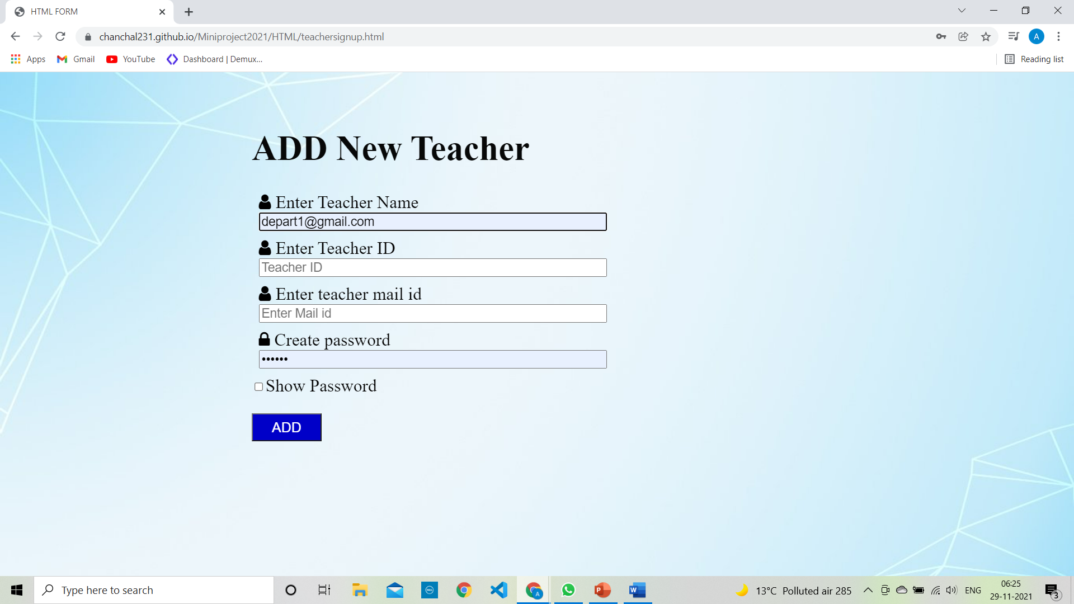

Slide 26
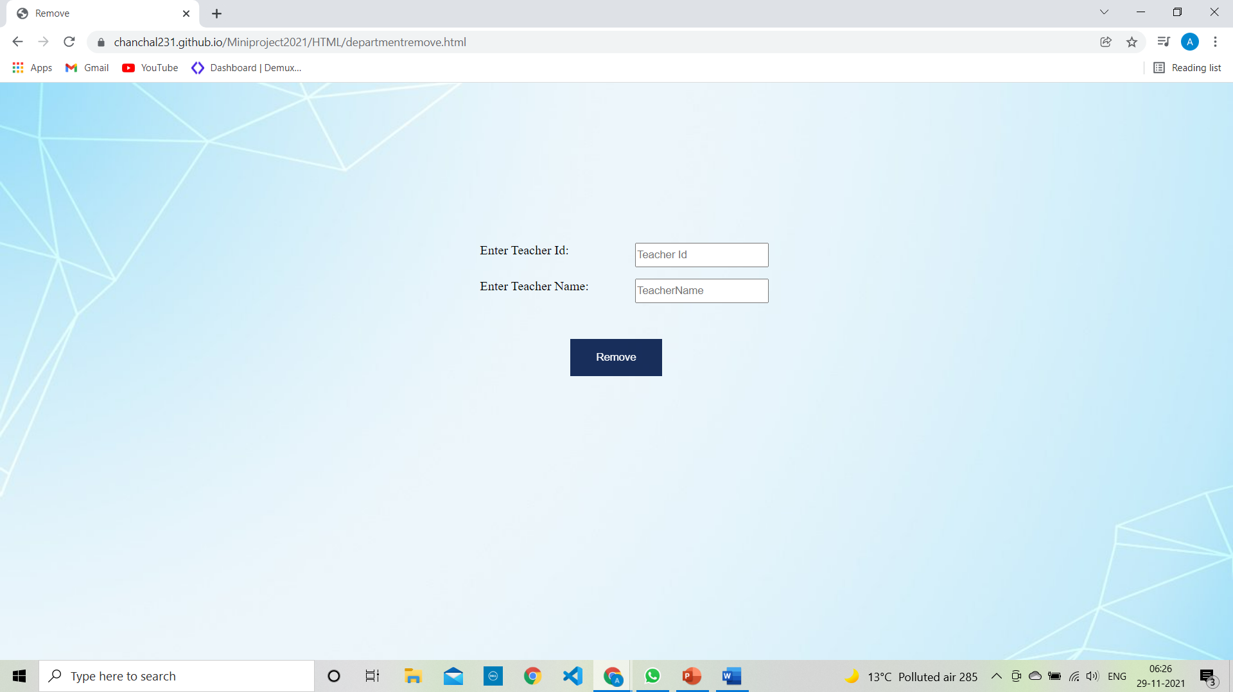

Slide 27
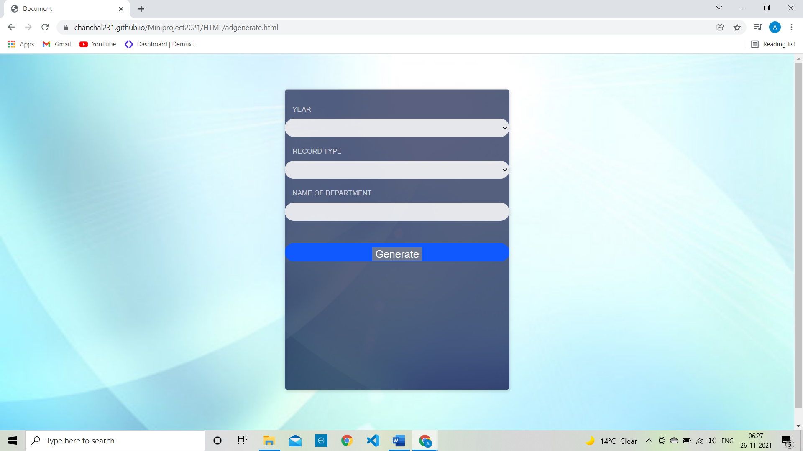

Slide 28
Teacher module Login 1.Add Record 2. View Record

Slide 29


Slide 30
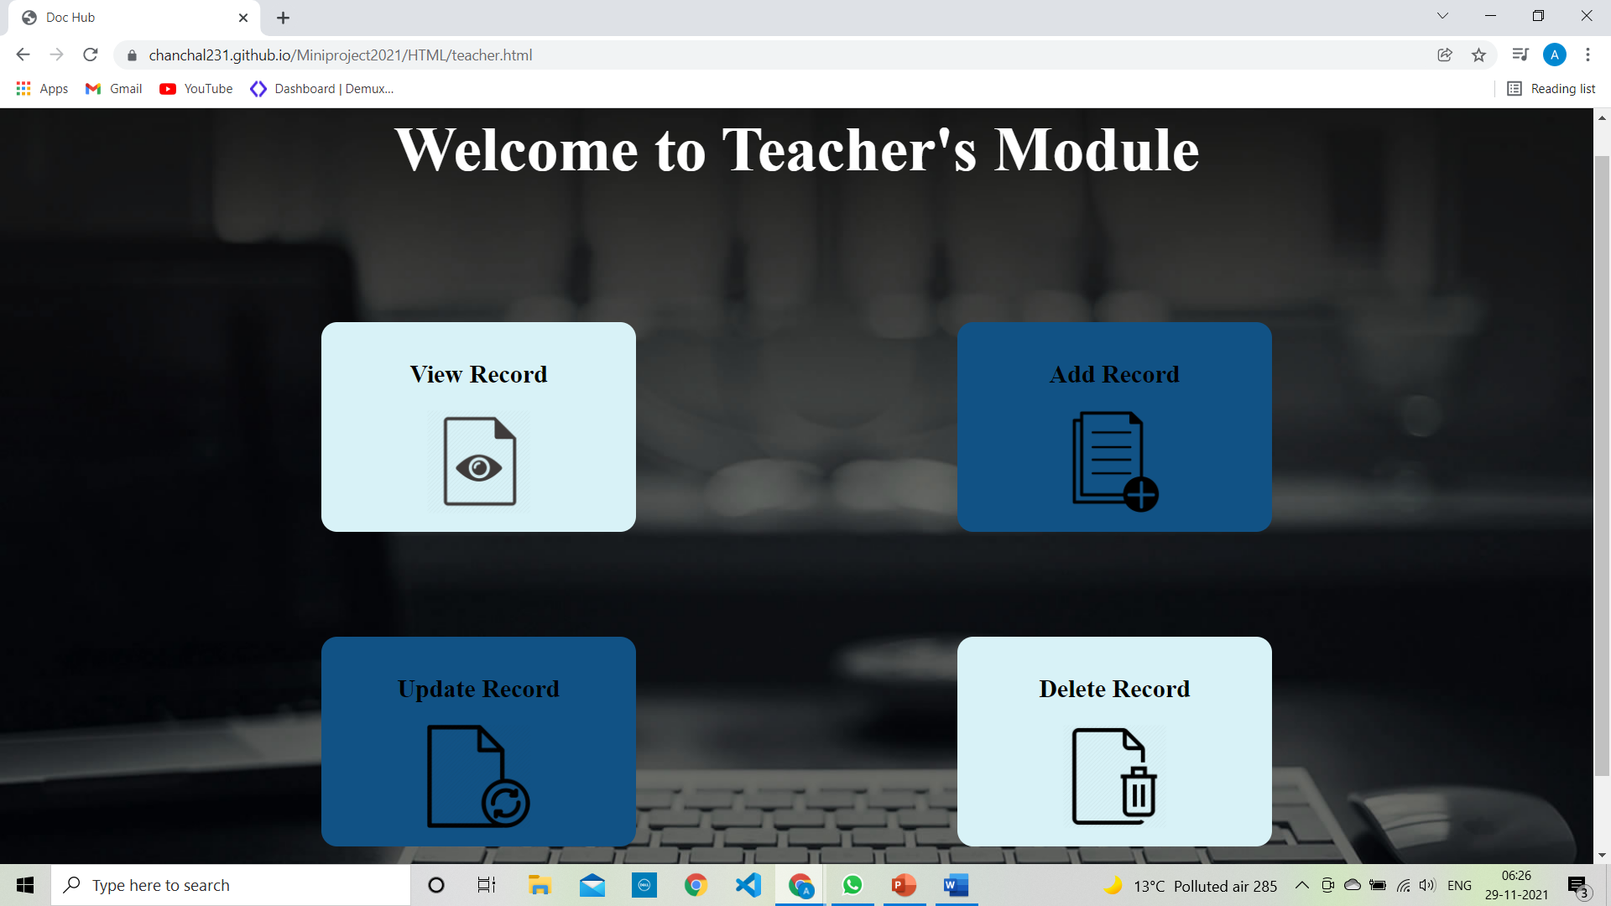

Slide 31
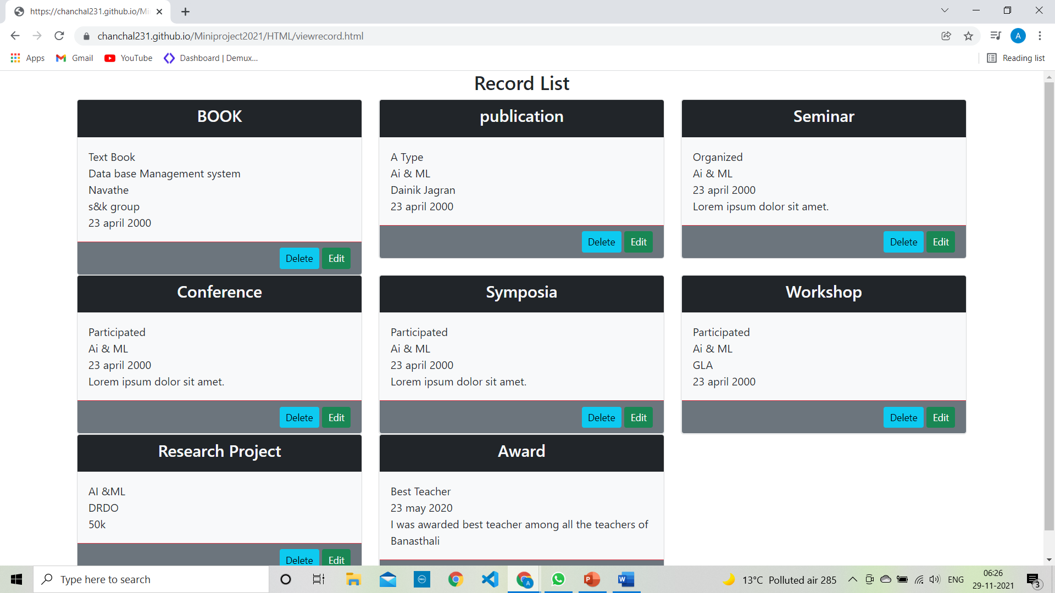

Slide 32
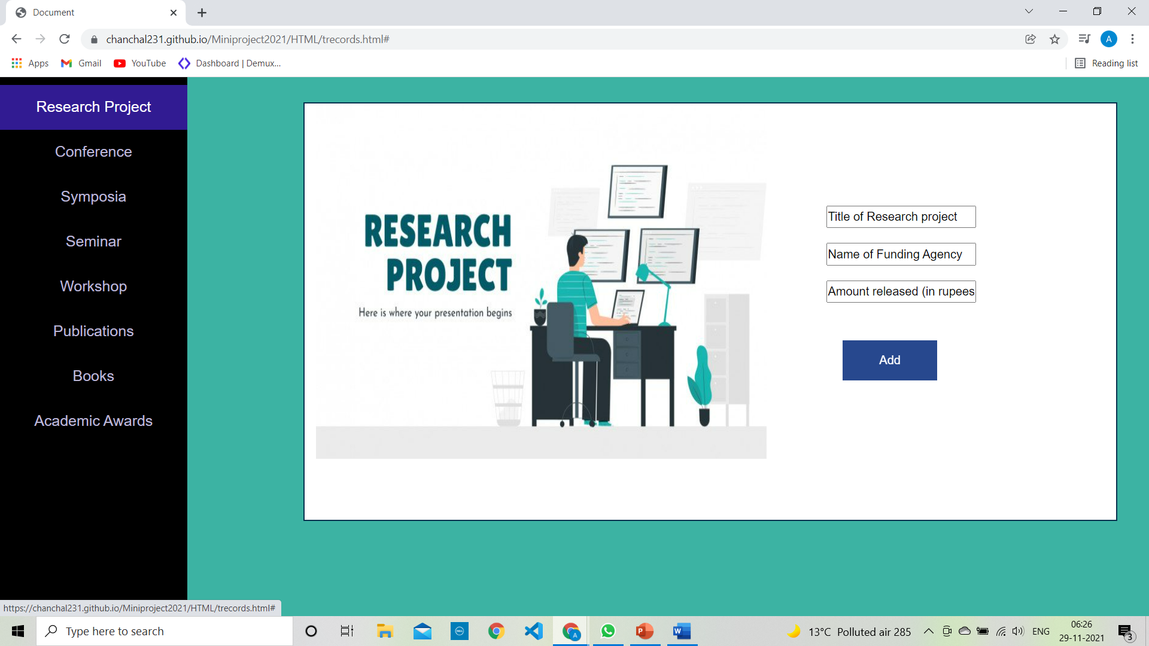

Slide 33
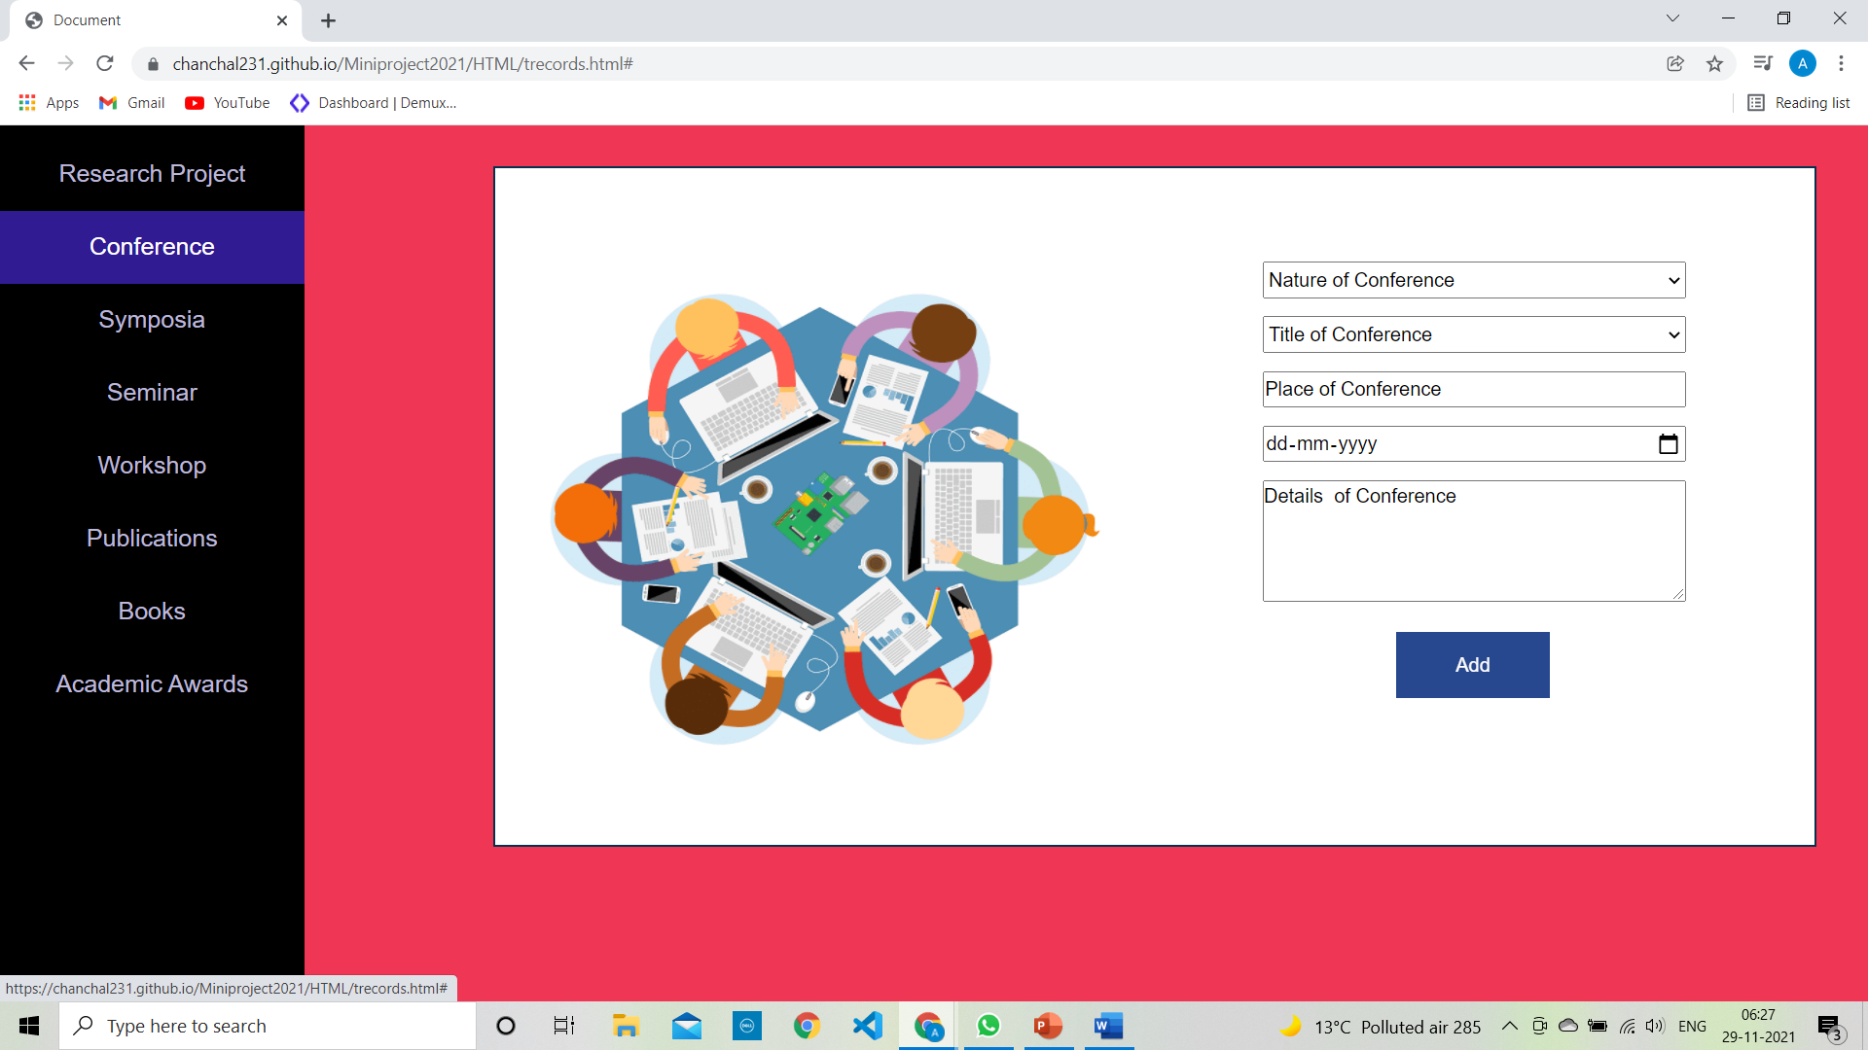

Slide 34
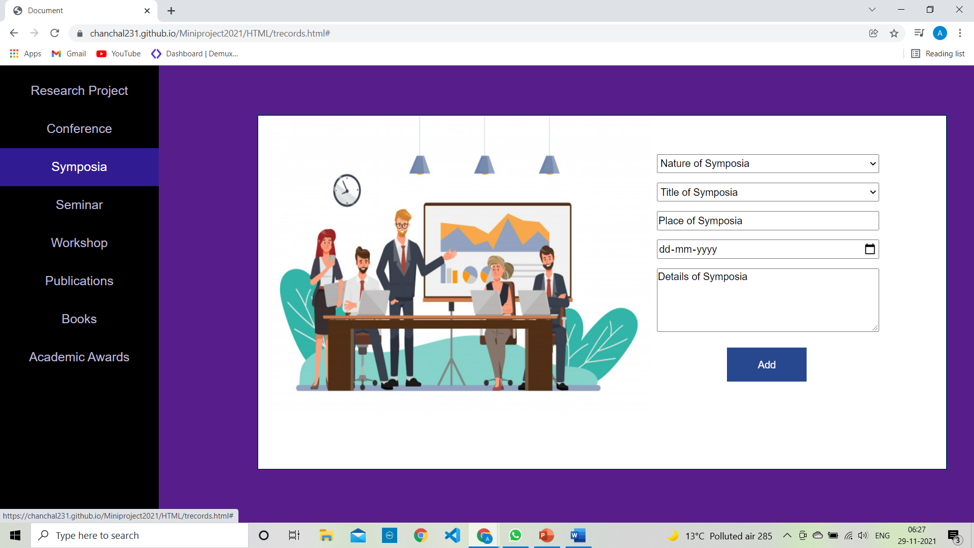

Slide 35
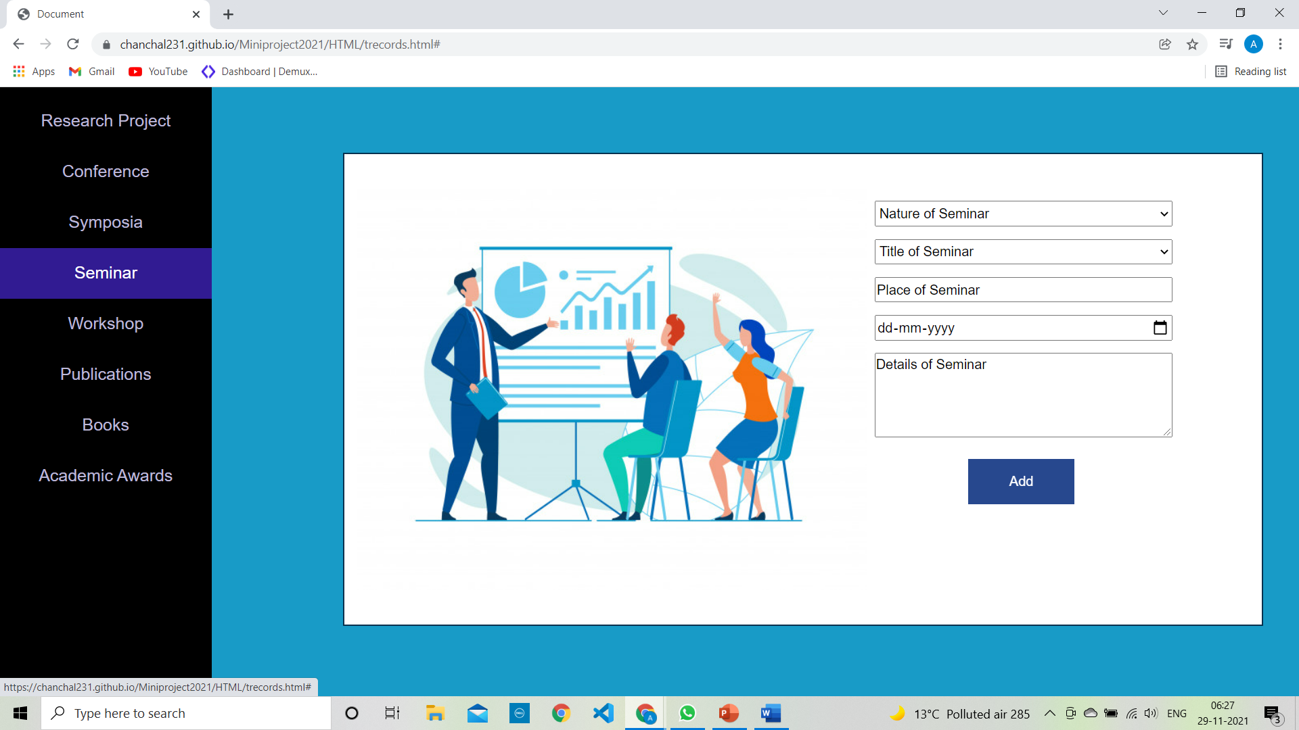

Slide 36
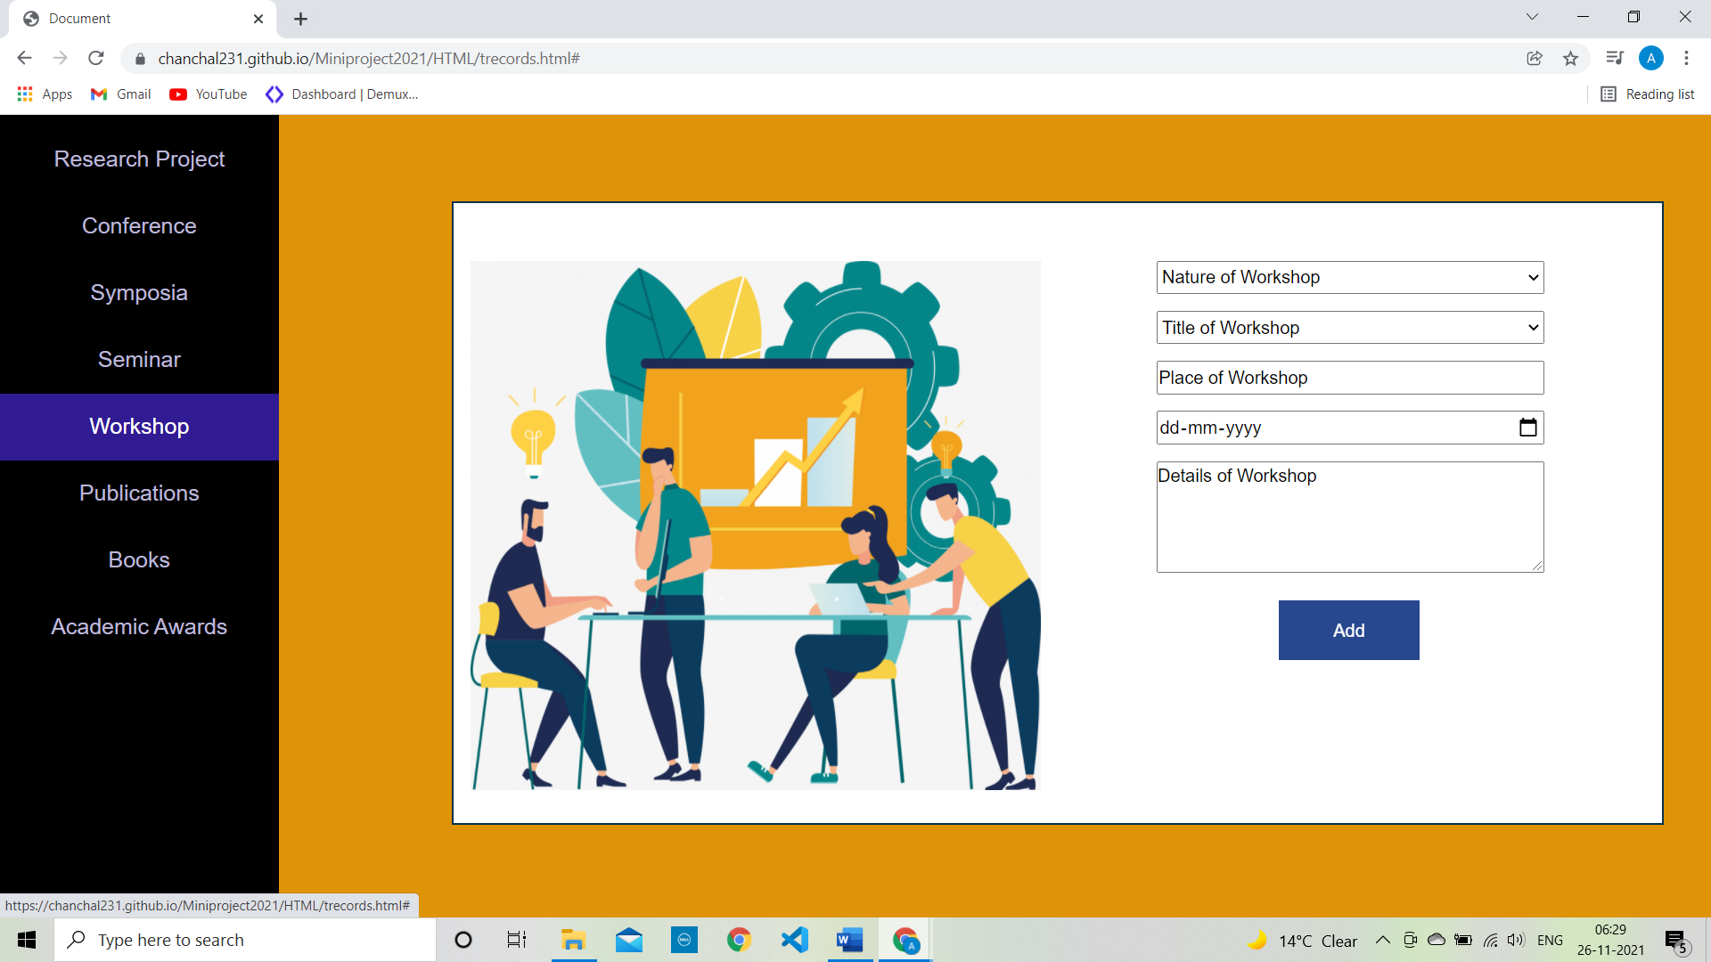

Slide 37
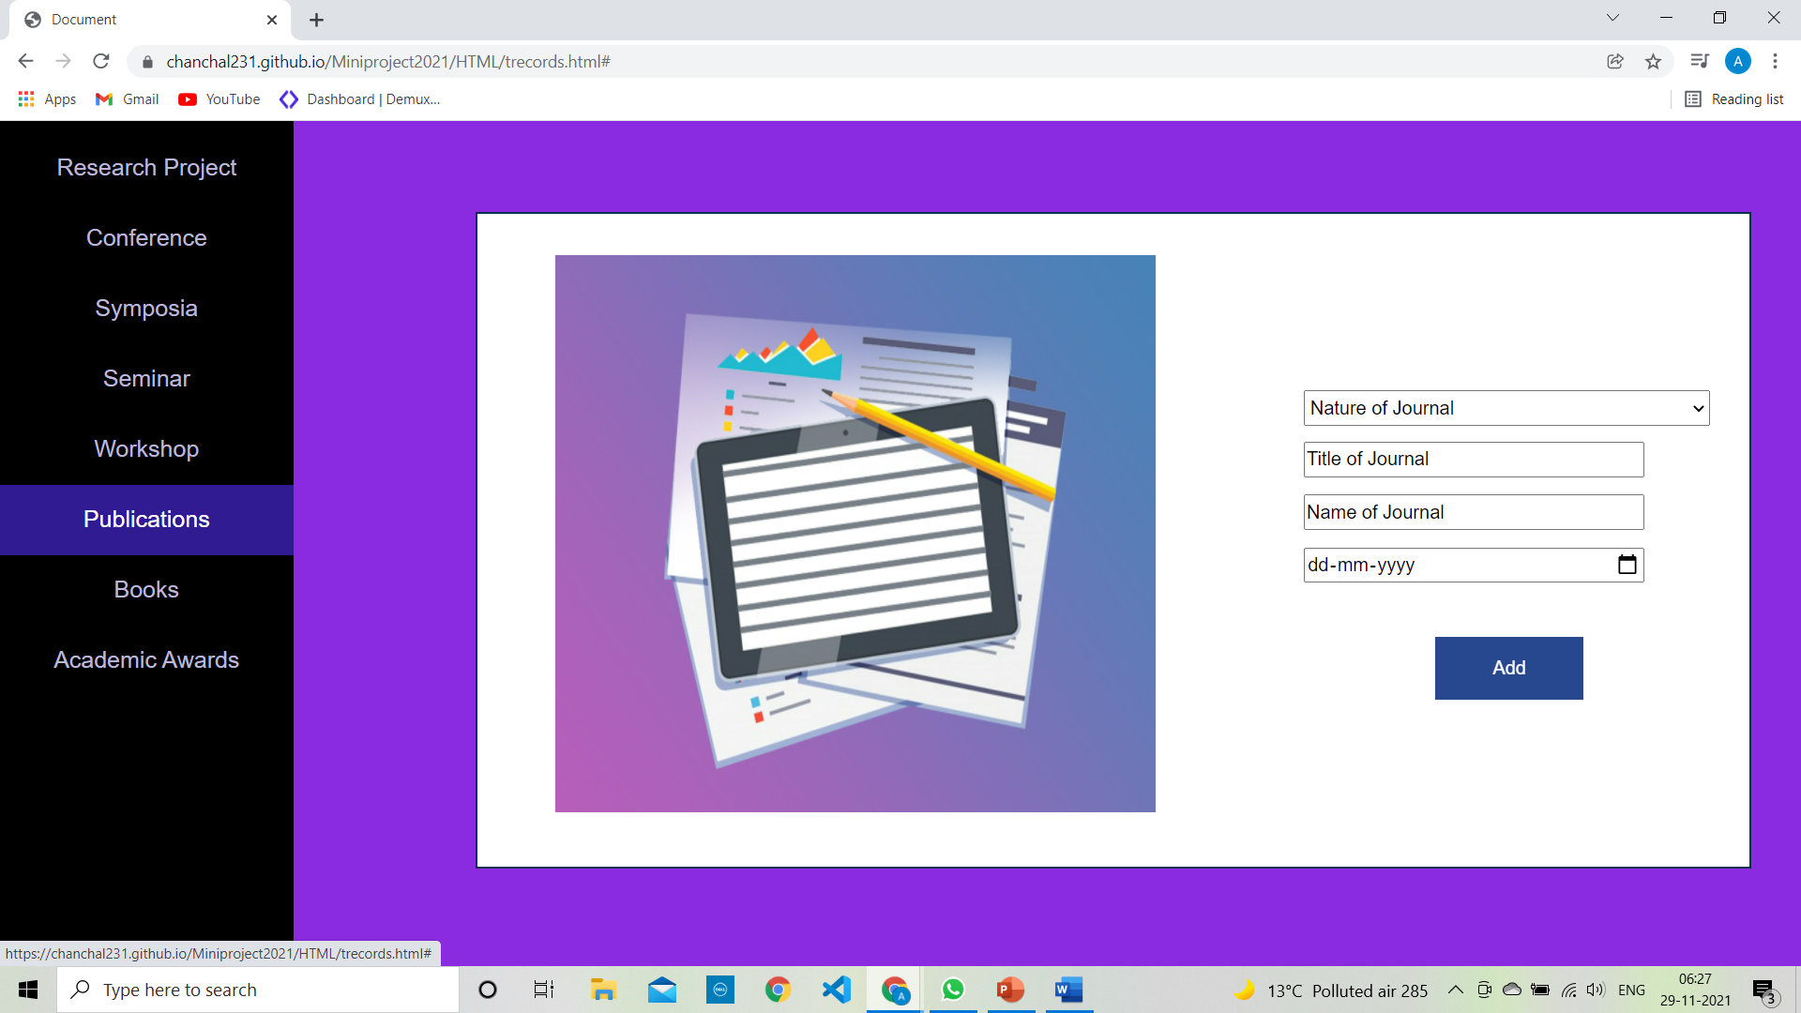

Slide 38
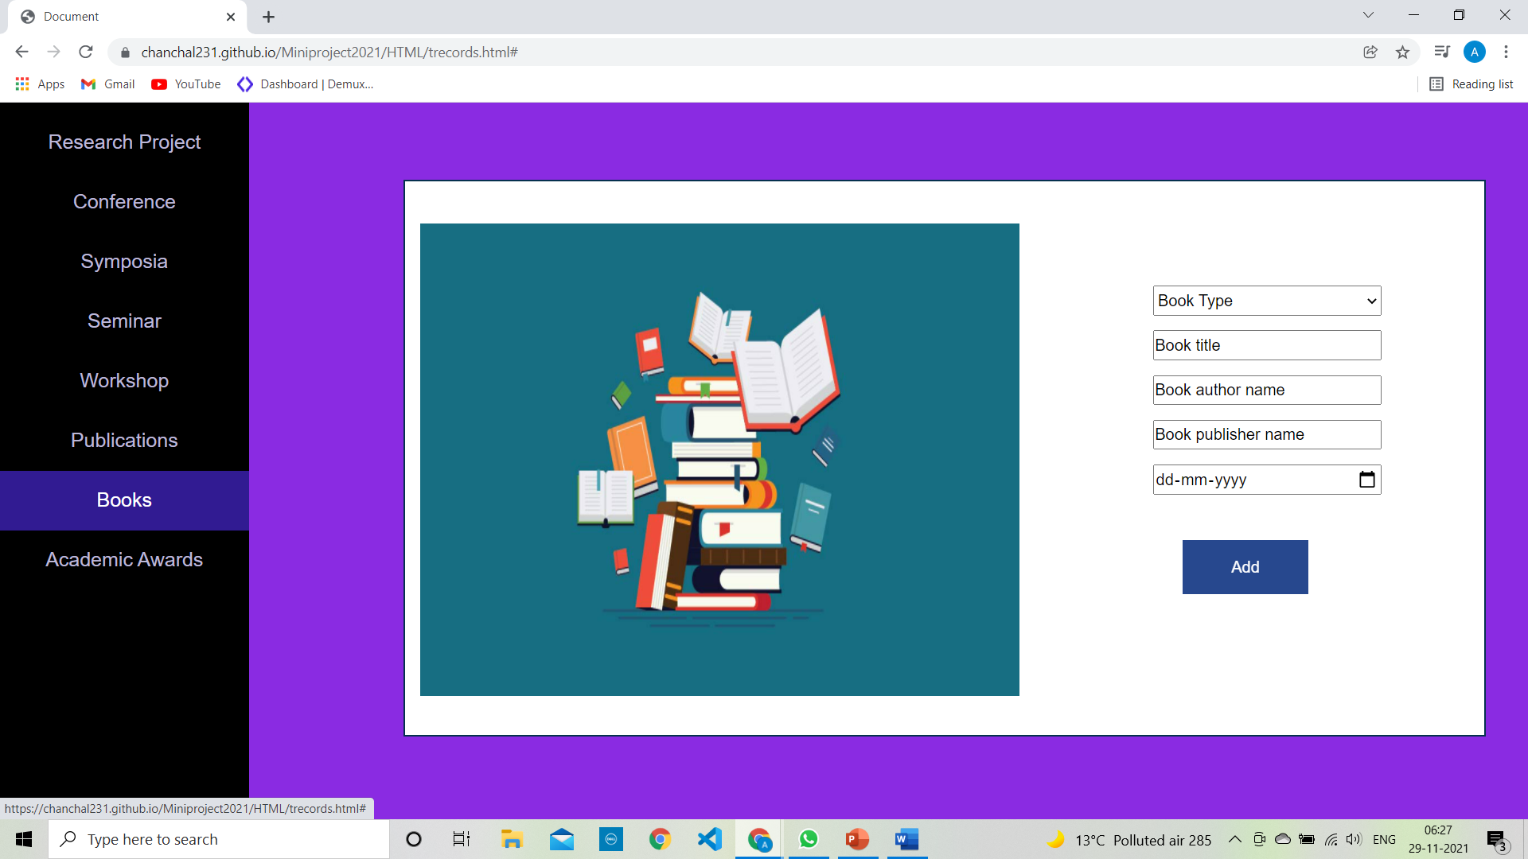

Slide 39
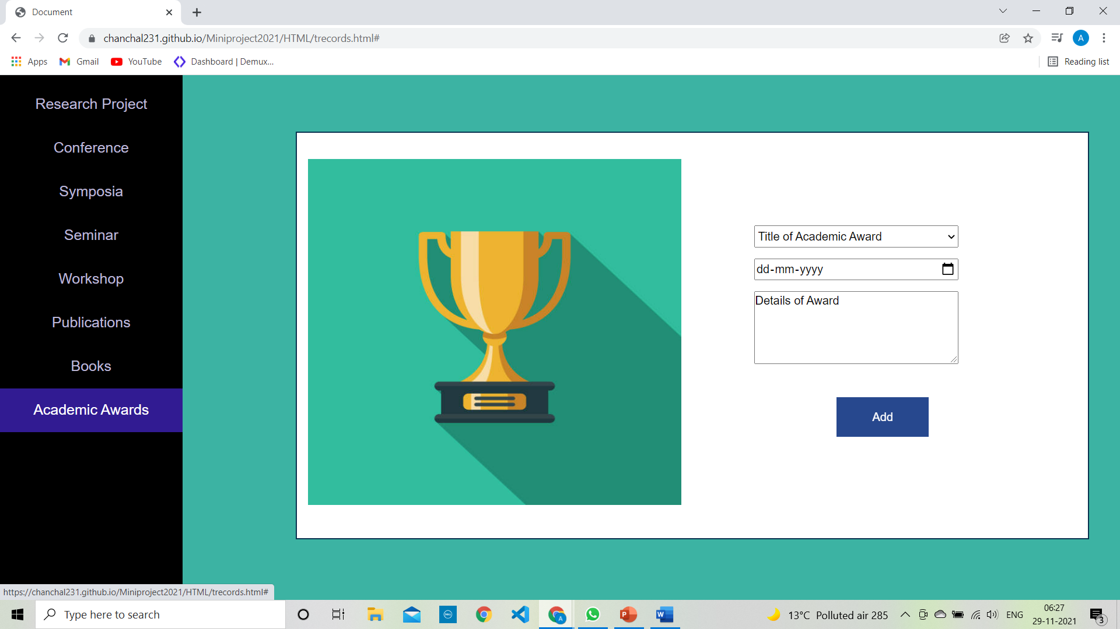

Slide 40
THANK YOU!!!

